Slide 1
HttpSession Interface:-
As we already know that HTTP is a stateless protocol, so it does not have any means for web server to identify multiple client requests (i.e. web server cannot know whether client made a request before too or not).
Java solve this problem by introducing HttpSession. Web container uses HttpSession to identify client requests across multiple client requests.
A session is a name(String)/value(Object) pair, stored at the server side.
Web container creates a separate session for each client, and it exists for a time specified by you at the time of creating session.

Slide 2
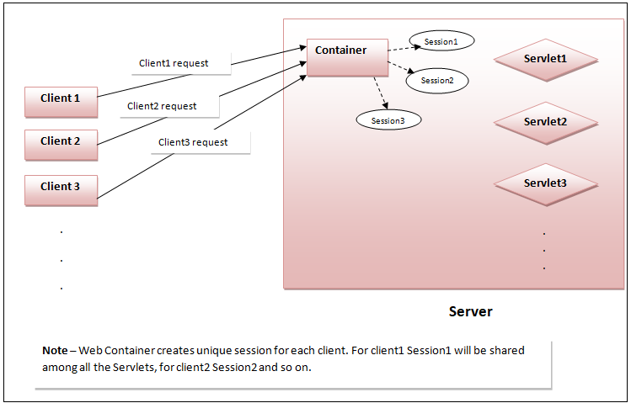
Whenever client made a request for the first time, web container automatically creates a unique
sessions ID (called JSessionID) for each client, that is used to identify clients across multiple requests.
Container creates a Cookie, embed the session ID in that and send back to the client as a part of server
response. Whenever client makes subsequent requests, he also sends its session ID with request.
Container sees the session ID to identify the client.

Slide 3
Getting a reference to HttpSession -
We can get a reference to HttpSession by using one of the following methods of HttpServletRequest-
1 - HttpSession getSession() - This method creates a new HttpSession if there is no session exists previously.
, or returns the existing session otherwise.
HttpSession session = request.getSession()
Where request is a HttpServletRequest.
2- HttpSession getSession(boolean state) - This method can do one of the following thing depending upon state value -
a- If state is set to false - It will return you existing HttpSession. If no session exists previously, it will not create any new session and returns null.
b- If state is set to true - It will return you existing session or create a new session if session does not exists previously.
HttpSession session = request.getSession(true/false);
Where request belongs to HttpServletRequest.

Slide 4
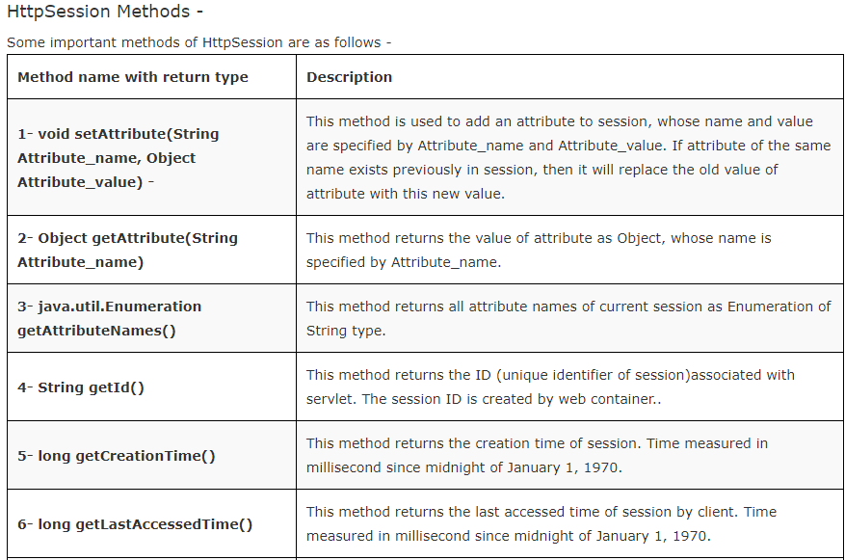

Slide 5
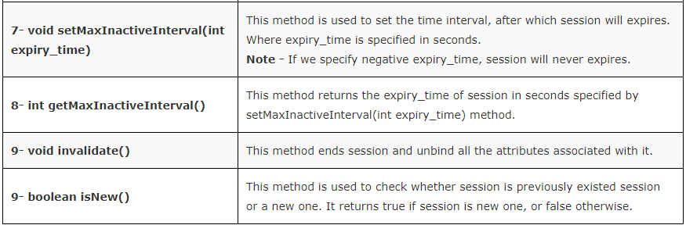

Slide 6
Example 1 -
This basic example will show you how to create a session, check whether session is new or existing one, how to set expiry time for session, and how to get servlet creation and last accessed time.
And finally we will see that container creates a unique session for each client, when client makes first request.
1- index.html or index.jsp - This will be your default page.
<!DOCTYPE html>
<html>
<head>
<title>Session Demo</title>
</head>
<body>
<a href="FirstServ">Click Here to show session information </a>
</body>
</html>

Slide 7
2- Create a package named servs and within servs create a servlet named FirstServ.
package servs;
import java.io.*;
import javax.servlet.*;
import javax.servlet.http.*;
public class FirstServ extends HttpServlet {
public void doGet(HttpServletRequest request, HttpServletResponse response)
throws ServletException, IOException {
try
{
PrintWriter out = response.getWriter();
HttpSession session = request.getSession();
if(session.isNew()) // checking whether session is new one or existing one.
{
out.println("This is new session");
}

Slide 8
else
{
out.println("This is previously existed session");
}
// Setting session timeout to one hour
session.setMaxInactiveInterval(60*60); // 60*60(seconds) = 1 hour
// Getting session id, creation time and last accessed time.
out.println("Session id is - "+ session.getId());
out.println("Session creation time - "+ (new java.util.Date(session.getCreationTime())));
out.println("Session last accessed time - "+ (new java.util.Date(session.getLastAccessedTime())));
}
catch(Exception ex)
{
System.out.println(ex);
}
}
}

Slide 9
3- web.xml -
<web-app>
<servlet>
<servlet-name>FirstServ</servlet-name>
<servlet-class>servs.FirstServ</servlet-class>
</servlet>
<servlet-mapping>
<servlet-name>FirstServ</servlet-name>
<url-pattern>/FirstServ</url-pattern>
</servlet-mapping>
</web-app>

Slide 10
Ending a session -
There are 3 ways a session can end -
1- The application shut down.
2- Session expiry time over.
3- You call invalidate() method
Setting session expiry time -
We can define same expiry time for all sessions in web app or define different expiry time for different session instances -
1- Setting same expiry time for all sessions -
If we want to set the same expiry time for all the sessions, we can define it in deployment descriptor (web.xml) as follows -
<web-app>
<servlet>
......
</servlet>
<servlet-mapping>
.......
</servlet-mapping>

Slide 11
<session-config>
<session-timeout>
30
<!--
// note time is specified in minutes.
// If client does not make any request for 30 minutes, session will expire.
-->
</session-timeout>
</session-config>
</web-app>
2- Setting different expiry time for different sessions -
We can define different expiry time for different sessions using setMaxInactiveInterval() method as follows -
session.setMaxInactiveInterval(60*30); // Note time is specified in second.
// If client does not make any request for 30 minutes, this session will expire.
Note -
If we deine the session expiry time in both ways, then second one has the priority i.e. session will expire depending upon the expiry time defined in setMaxInactiveInterval() method.

Slide 12
Example 2 -
In this example we will use session to identify subsequent client requests.
Example 2.1 - TO better understand why to use sessions, let us first see what problem will occur if we do not use session. index.html or index.jsp -
<!DOCTYPE html>
<html>
<head>
<title>HttpSessionDemo2</title>
</head>
<body>
<form method="post" action="LoginCheck">
<table border="1px">
<tr>
<td>User Name </td>
<td><input type="text" name="t1" placeholder="Enter name"></td>
</tr>
<tr>
<td>Password </td>
<td><input type="password" name="t2" placeholder="Enter password"></td>
</tr>

Slide 13
<tr>
<td><input type="submit" value="Login"></td>
<td><input type="reset" value="Reset"></td>
</tr>
</table>
</form>
</body>
</html>

Slide 14
2 - Create a package named servs and within servs create a servlets named LoginCheck and Home.
LoginCheck Servlet -
package servs;
import java.io.*;
import javax.servlet.*;
import javax.servlet.http.*;
public class LoginCheck extends HttpServlet {
public void doPost(HttpServletRequest request, HttpServletResponse response)
throws ServletException, IOException {
try
{
PrintWriter out = response.getWriter();
String nm = request.getParameter("t1");
String ps = request.getParameter("t2");
if(nm.equals("admin") && ps.equals("123"))
{
response.sendRedirect("Home");
}

Slide 15
else
{
out.println("<h1 style='color:red'>Wrong user name or password</h1>");
RequestDispatcher rdp = request.getRequestDispatcher("index.html");
rdp.include(request, response);
}
}
catch(Exception ex)
{
System.out.println(ex);
}
}
}

Slide 16
Home Servlet -
package servs;
import java.io.*;
import javax.servlet.*;
import javax.servlet.http.*;
public class Home extends HttpServlet {
public void doGet(HttpServletRequest request, HttpServletResponse response)
throws ServletException, IOException {
try
{
PrintWriter out = response.getWriter();
out.println("<h1 style='padding:10px'>Home Page</h1>");
out.println("<hr>");
out.println("Welcome to Home");
}
catch(Exception ex)
{
System.out.println(ex);
}
}
}

Slide 18
3- web.xml Add the following code to web.xml -
<web-app>
<servlet>
<servlet-name>LoginCheck</servlet-name>
<servlet-class>servs.LoginCheck</servlet-class>
</servlet>
<servlet>
<servlet-name>Home</servlet-name>
<servlet-class>servs.Home</servlet-class>
</servlet>
<servlet-mapping>
<servlet-name>LoginCheck</servlet-name>
<url-pattern>/LoginCheck</url-pattern>
</servlet-mapping>
<servlet-mapping>
<servlet-name>Home</servlet-name>
<url-pattern>/Home</url-pattern>
</servlet-mapping>
</web-app>

Slide 19
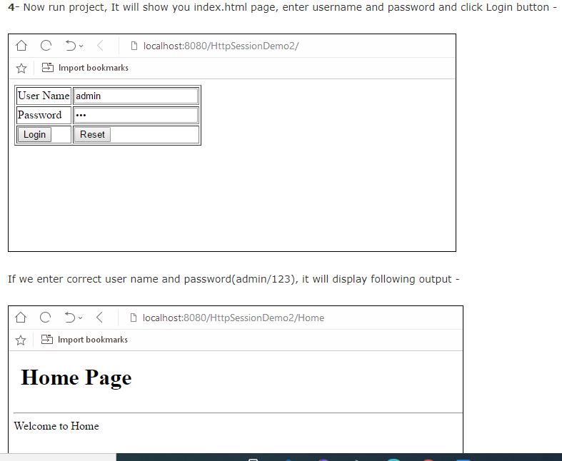

Slide 20
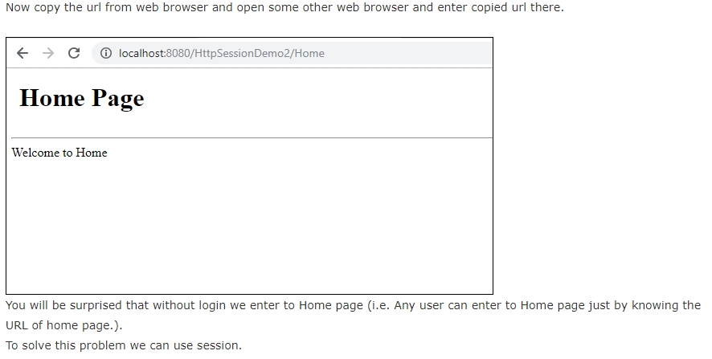

Slide 21
Example 2.2 - To solve the above problem we can use Session as follows -
index.html or index.jsp -
<!DOCTYPE html>
<html>
<head>
<title>HttpSessionDemo2</title>
</head>
<body>
<form method="post" action="LoginCheck">
<table border="1px">
<tr>
<td>User Name </td>
<td><input type="text" name="t1" placeholder="Enter name"></td>
</tr>
<tr>
<td>Password </td>
<td><input type="password" name="t2" placeholder="Enter password"></td>
</tr>

Slide 22
<tr>
<td><input type="submit" value="Login"></td>
<td><input type="reset" value="Reset"></td>
</tr>
</table>
</form>
</body>
</html>

Slide 23
2 - Create a package named servs and within servs create following servlets -
LoginCheck Servlet -
package servs;
import java.io.*;
import javax.servlet.*;
import javax.servlet.http.*;
public class LoginCheck extends HttpServlet {
public void doPost(HttpServletRequest request, HttpServletResponse response)
throws ServletException, IOException {
try
{
PrintWriter out = response.getWriter();
HttpSession session = request.getSession();
String nm = request.getParameter("t1");
String ps = request.getParameter("t2");
if(nm.equals("admin") && ps.equals("123"))
{
session.setAttribute("Name", nm);
response.sendRedirect("Home");
}

Slide 24
else
{
out.println("<h1 style='color:red'>Wrong user name or password</h1>");
RequestDispatcher rdp = request.getRequestDispatcher("index.html");
rdp.include(request, response);
}
}
catch(Exception ex)
{
System.out.println(ex);
}
}
}

Slide 25
Home Servlet -
package servs;
import java.io.*;
import javax.servlet.*;
import javax.servlet.http.*;
public class Home extends HttpServlet {
public void doGet(HttpServletRequest request, HttpServletResponse response)
throws ServletException, IOException {
try
{
HttpSession session = request.getSession();
if(session.getAttribute("Name") == null)
{
response.sendRedirect("index.html");
}
PrintWriter out = response.getWriter();

Slide 26
out.println("<h1 style='padding:10px'>Welcome to Home</h1>");
out.println("<hr>");
out.print("<a href='Gallery'>Gallery</a>");
out.print("<a href='Logout'>Logout</a>");
}
catch(Exception ex)
{
System.out.println(ex);
}
}
}

Slide 27
Gallery Servlet -
package servs;
import java.io.*;
import javax.servlet.*;
import javax.servlet.http.*;
public class Gallery extends HttpServlet {
public void doGet(HttpServletRequest request, HttpServletResponse response)
throws ServletException, IOException {
try
{
HttpSession session = request.getSession();
if(session.getAttribute("Name") == null)
{
response.sendRedirect("index.html");
}
PrintWriter out = response.getWriter();
out.println("<h1>Welcome to gallery</h1>");
}
catch(Exception ex)
{
System.out.println(ex);
}
}
}

Slide 28
Logout Servlet -
package servs;
import java.io.*;
import javax.servlet.*;
import javax.servlet.http.*;
public class Logout extends HttpServlet {
public void doGet(HttpServletRequest request, HttpServletResponse response)
throws ServletException, IOException {
try
{
HttpSession session = request.getSession();
session.invalidate(); // destroy all sessions and go back to Login form.
response.sendRedirect("index.html");
}
catch(Exception ex)
{
System.out.println(ex);
}
}
}

Slide 29
3- web.xml Add the following code to web.xml -
<web-app>
<servlet>
<servlet-name>LoginCheck</servlet-name>
<servlet-class>servs.LoginCheck</servlet-class>
</servlet>
<servlet>
<servlet-name>Home</servlet-name>
<servlet-class>servs.Home</servlet-class>
</servlet>
<servlet>
<servlet-name>Gallery</servlet-name>
<servlet-class>servs.Gallery</servlet-class>
</servlet>
<servlet>
<servlet-name>Logout</servlet-name>
<servlet-class>servs.Logout</servlet-class>
</servlet>
<servlet-mapping>
<servlet-name>LoginCheck</servlet-name>
<url-pattern>/LoginCheck</url-pattern>
</servlet-mapping>

Slide 30
<servlet-mapping>
<servlet-name>Home</servlet-name>
<url-pattern>/Home</url-pattern>
</servlet-mapping>
<servlet-mapping>
<servlet-name>Gallery</servlet-name>
<url-pattern>/Gallery</url-pattern>
</servlet-mapping>
<servlet-mapping>
<servlet-name>Logout</servlet-name>
<url-pattern>/Logout</url-pattern>
</servlet-mapping>
</web-app>

Slide 31
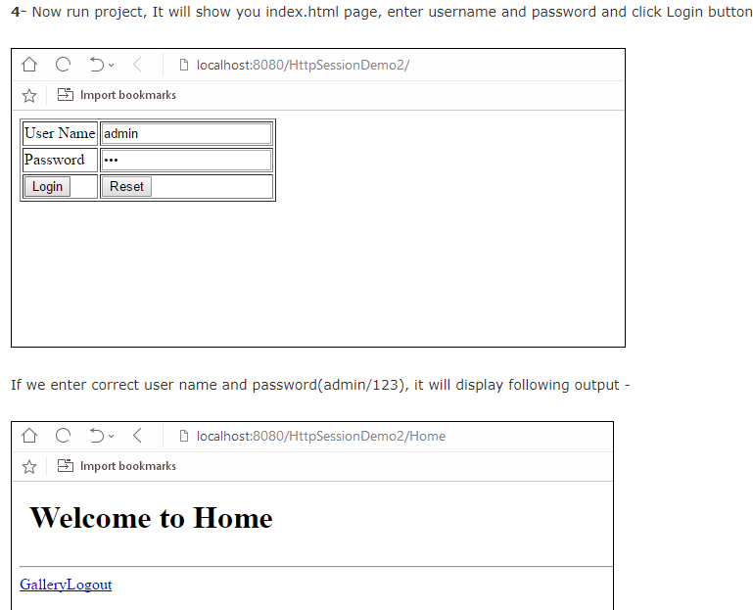

Slide 32
